Slide 1
Activity Planning
Hamish Dickson

Slide 2
Guidelines
Checklist
Create list of tasks that will be carried out in the project
Establish the order of these tasks
Create milestones
Calculate the timescale
Allocate resources to each task
Review and update your activity plan regularly

Slide 3
Modelling relationships between tasks

Slide 4
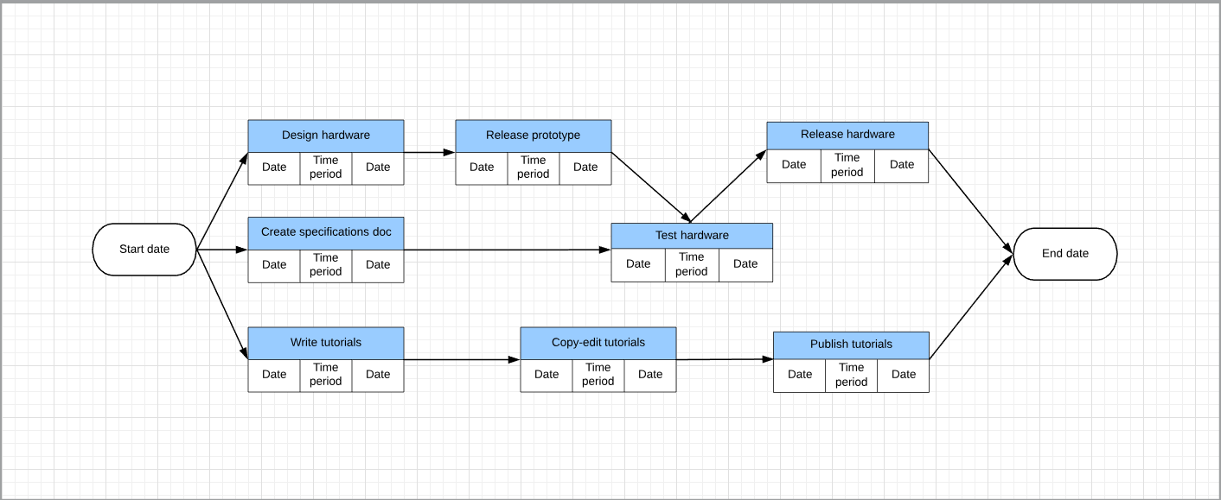
PERT chart

Slide 5
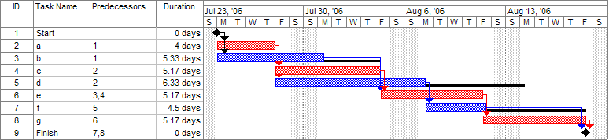
Gantt chart

Slide 6
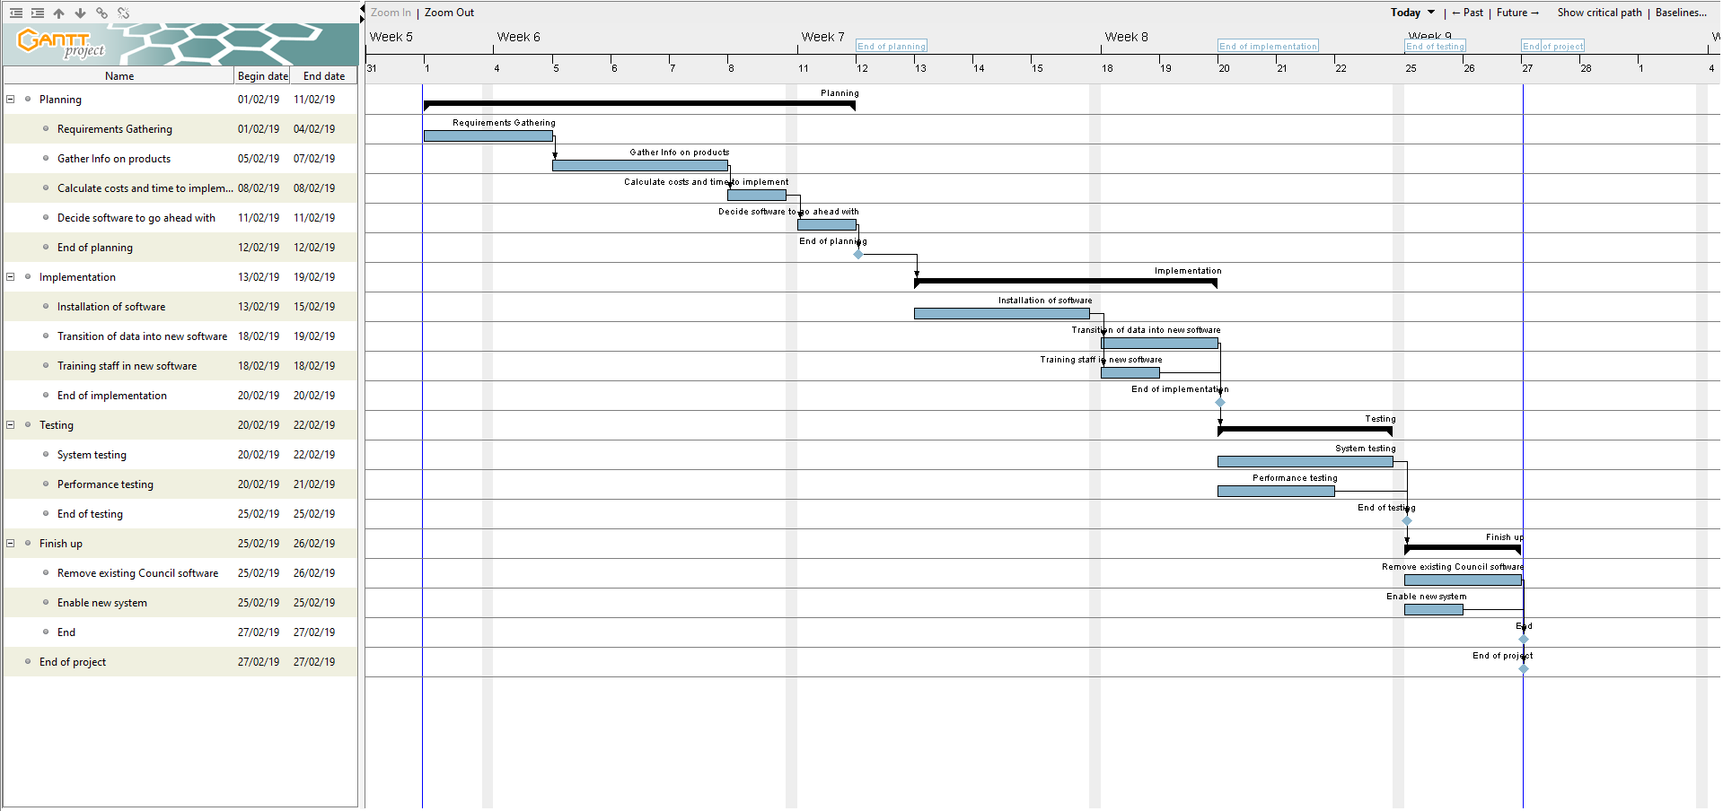
Brightmouth College activity plan

Slide 7
Thanks for listening
I’m happy to answer any questions.

